Slide 1







IBM Capstone
Syeda Samiha Zafar
26-11-2023

Slide 2



OUTLINE
Executive Summary
Introduction
Methodology
Results
Visualization – Charts
Dashboard
Discussion
Findings & Implications
Conclusion
Appendix

Slide 3

EXECUTIVE SUMMARY
Point1
Point2
Sub Point 1
Sub Point 2
Sub Point 3
Point3
Point4
Point5

Slide 4

INTRODUCTION
Point1
Point2
Point3
Point4
Sub Point1
Sub Point2

Slide 5

METHODOLOGY
Point1
Point2
Point3
Point4
Sub Point1
Sub Point2

Slide 6
RESULTS

Slide 7
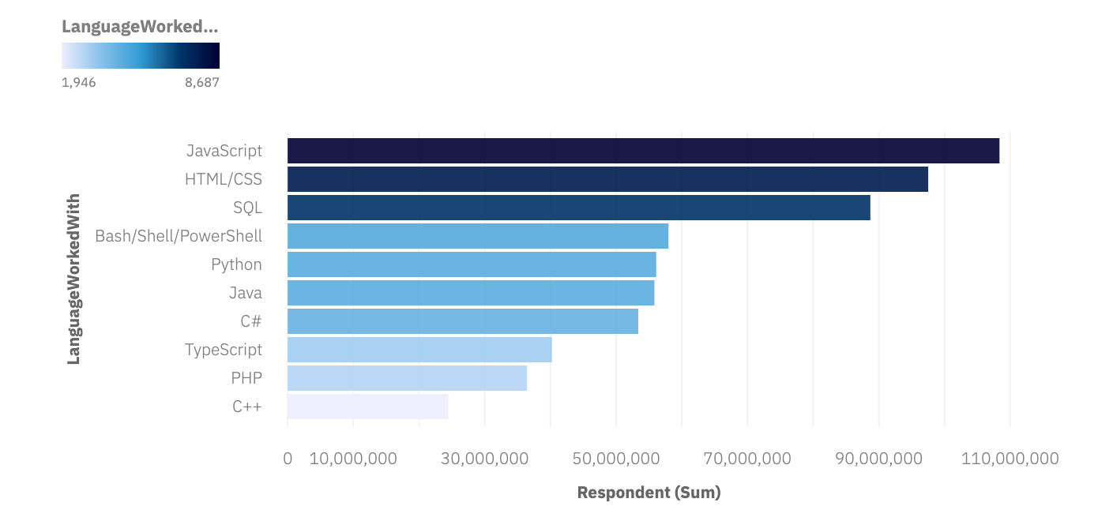
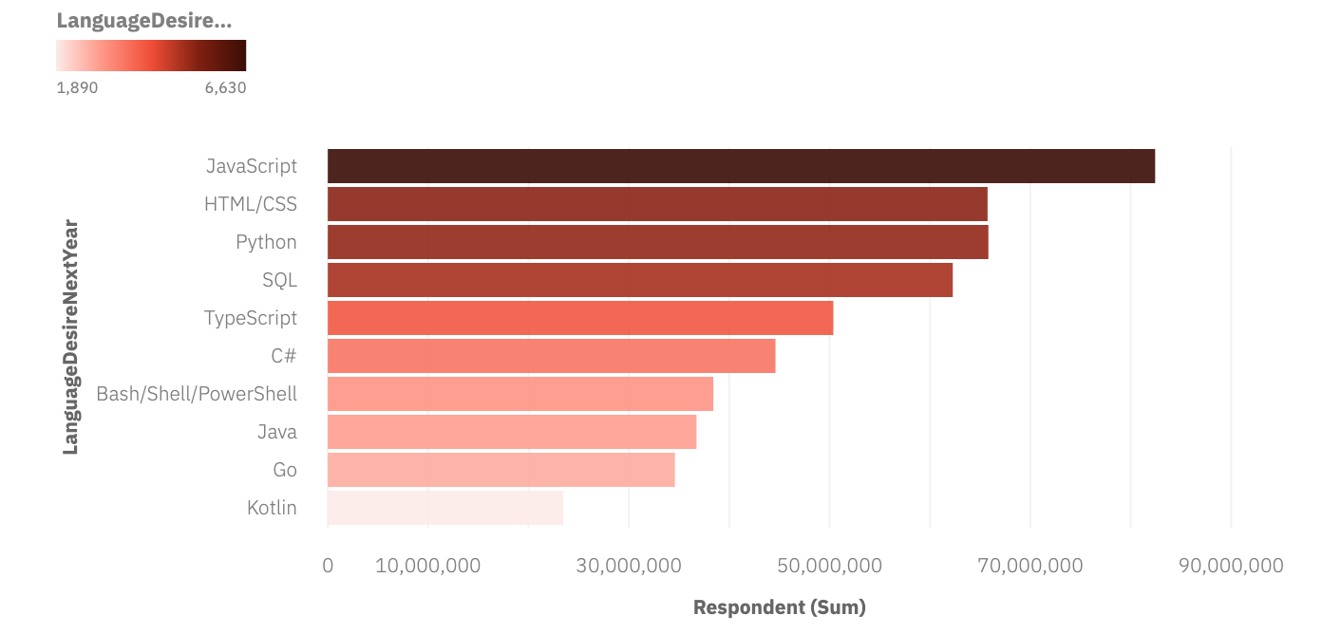
PROGRAMMING LANGUAGE TRENDS
Bar chart of top 10 programming languages for the current year
Bar chart of top 10 programming languages for the next year
Bar chart of top 10 programming languages for the current year goes here.

Slide 8
PROGRAMMING LANGUAGE TRENDS - FINDINGS & IMPLICATIONS
Based on current and next year programming language trends we get some key finding
JavaScript continues to be in high demand
Kotlin and Go are predicted to enter the top 10 list next year
On the other hand, the demand for PHP and C++ is expected to decline in the upcoming year.

Slide 9
PROGRAMMING LANGUAGE TRENDS - FINDINGS & IMPLICATIONS
Based on current and next year programming language trends we get some key implication:
JavaScript has been in high demand for web development
Kotlin and Go, owing to their strong performance, clear syntax, and specialized applications, are poised to experience heightened demand and greater adoption in the software development field.
May be C++ and Php demand will decreasing slightly due to the rise of other server-side languages and frameworks

Slide 10
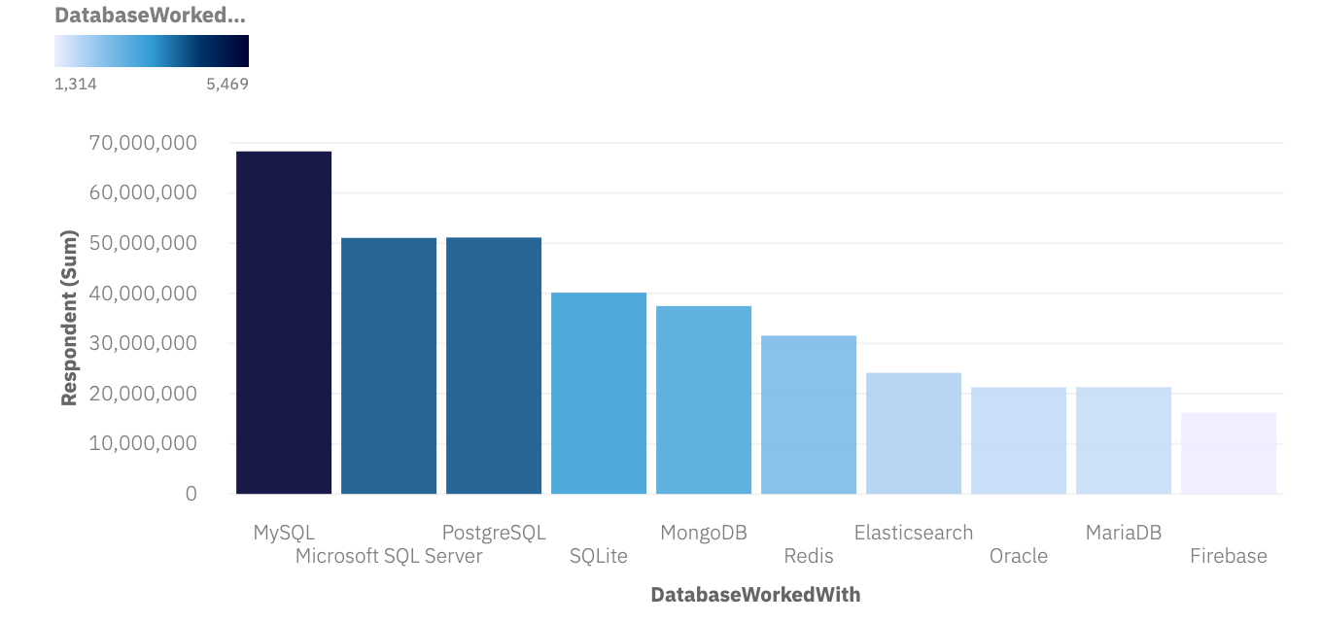
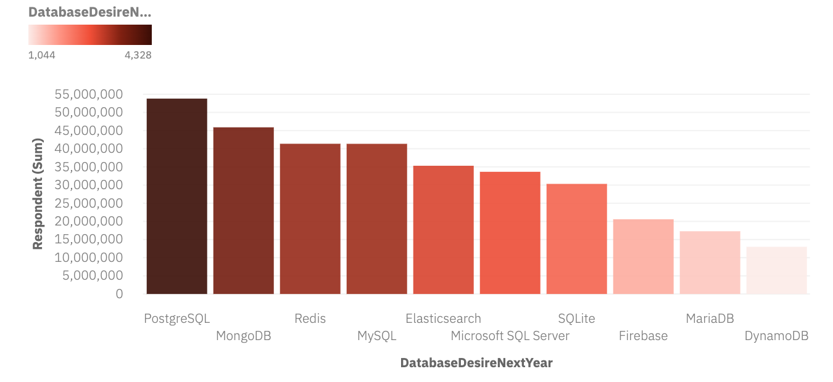
DATABASE TRENDS
Bar chart of top 10 databases for the current year
Bar chart of top 10 databases for the next year

Slide 11
DATABASE TRENDS - FINDINGS & IMPLICATIONS
Findings
Finding 1
Finding 2
Finding 3
Implications
Implication 1
Implication 2
Implication 3

Slide 12

DASHBOARD
The permanent link of the read-only view of the Cognos dashboard: https://dataplatform.cloud.ibm.com/dashboards/92b21d3a-b035-4671-bbb3-a9718f68db4d/view/501de12b25ea3ffc74d1bde4079c7a0e7e622d5ee3bb810682d17b490b342097a9614095c827490fdb430666f6e84458c0

Slide 13
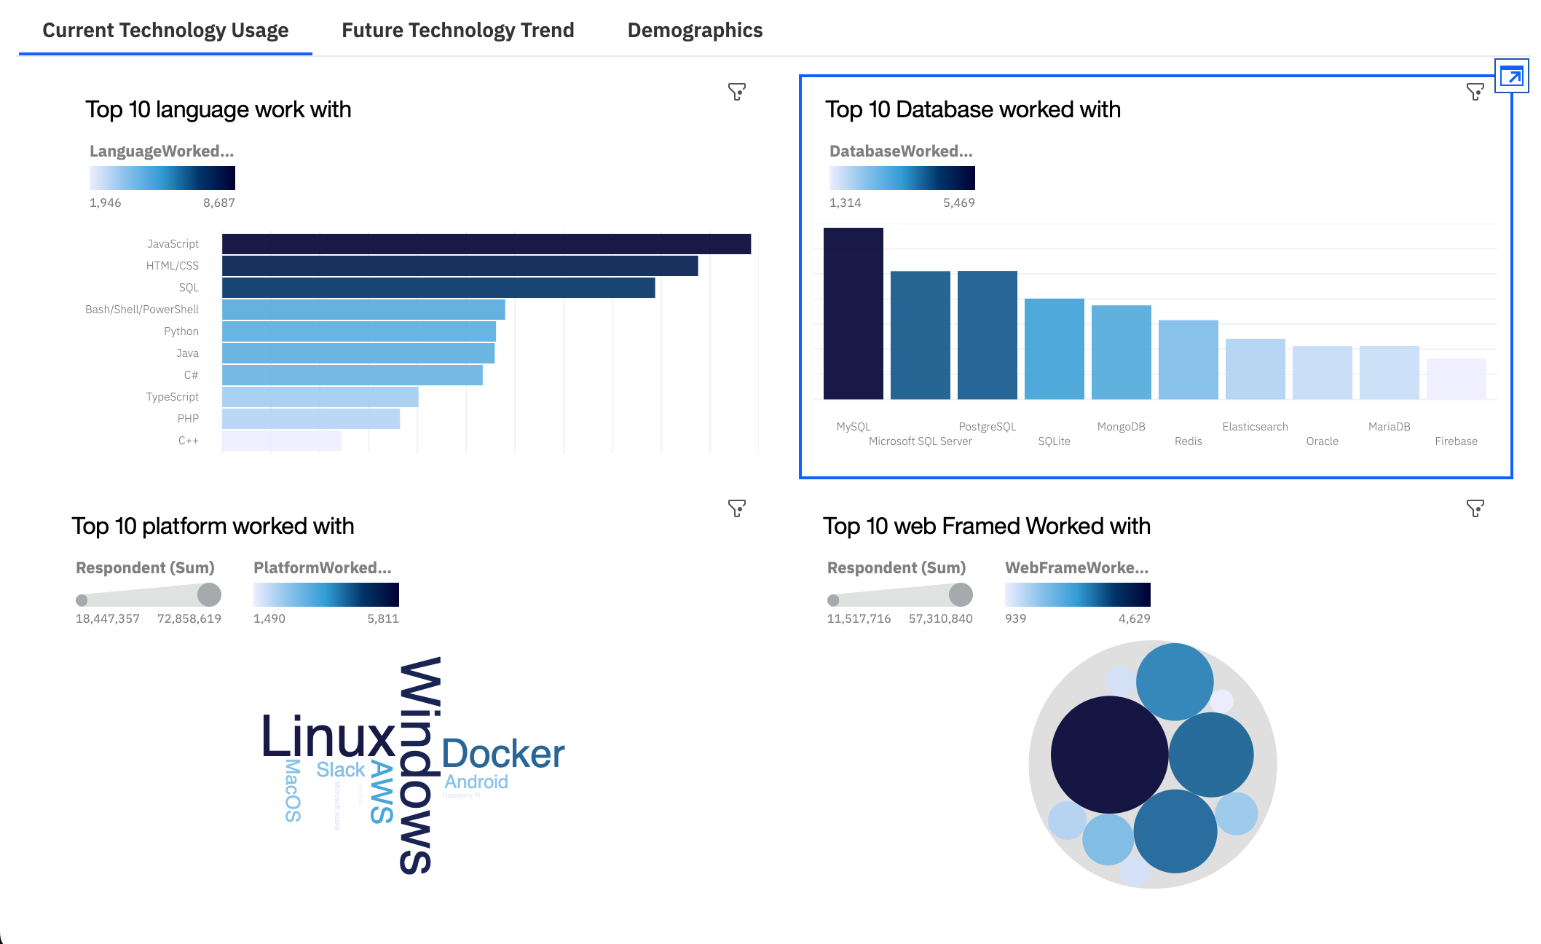
DASHBOARD TAB 1

Slide 14
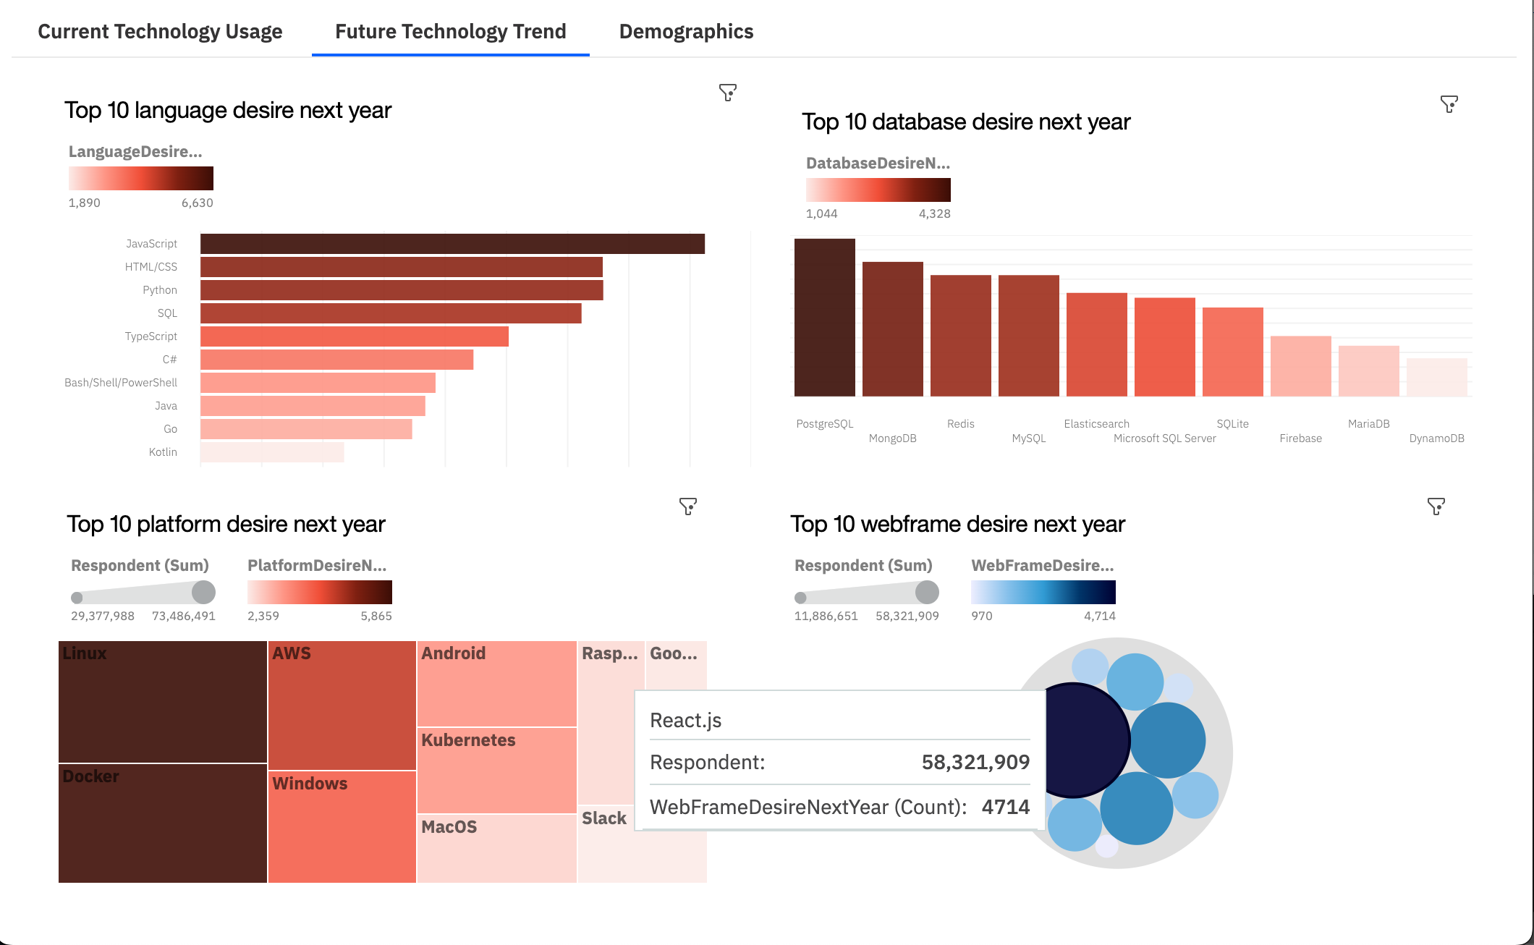
DASHBOARD TAB 2

Slide 15
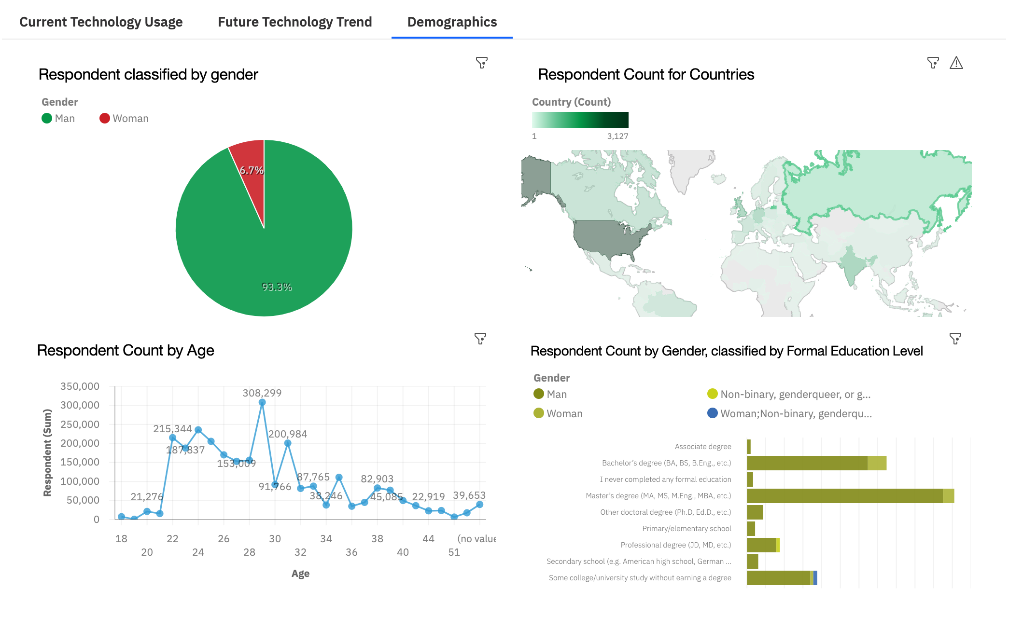
DASHBOARD TAB 3

Slide 16
DISCUSSION

Slide 17
OVERALL FINDINGS & IMPLICATIONS
Findings
Finding 1
Finding 2
Finding 3
Implications
Implication 1
Implication 2
Implication 3

Slide 18

CONCLUSION
Point 1
Point 2
Point 3
Point 4

Slide 19

APPENDIX
Include any relevant additional charts, or tables that you may have created during the analysis phase.

Slide 20
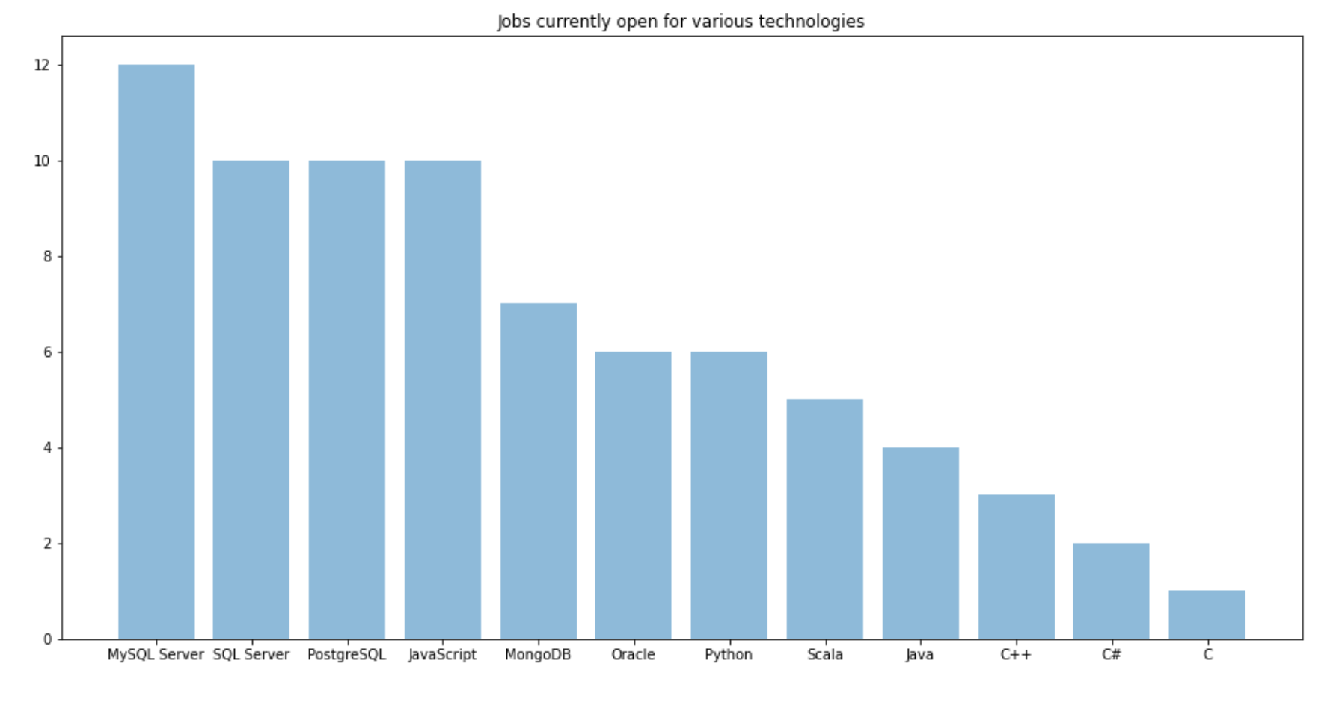
JOB POSTINGS
In Module 1 you have collected the job posting data using Job API in a file named “job-postings.xlsx”. Present that data using a bar chart here. Order the bar chart in the descending order of the number of job postings.

Slide 21
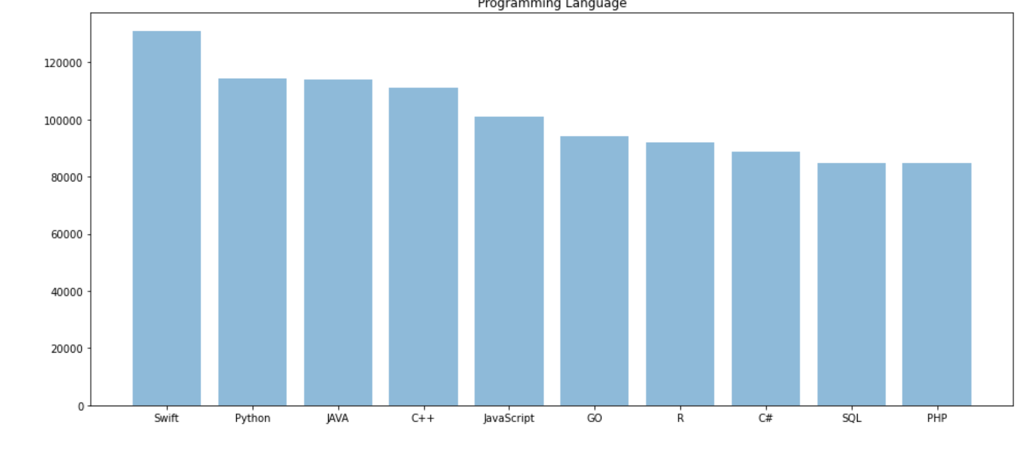
POPULAR LANGUAGES
In Module 1 you have collected the job postings data using web scraping in a file named “popular-languages.csv”. Present that data using a bar chart here. Order the bar chart in the descending order of salary.

